Slide 1
Project of Big Data Analisys
Using secondary Mushroom dataset

Slide 2
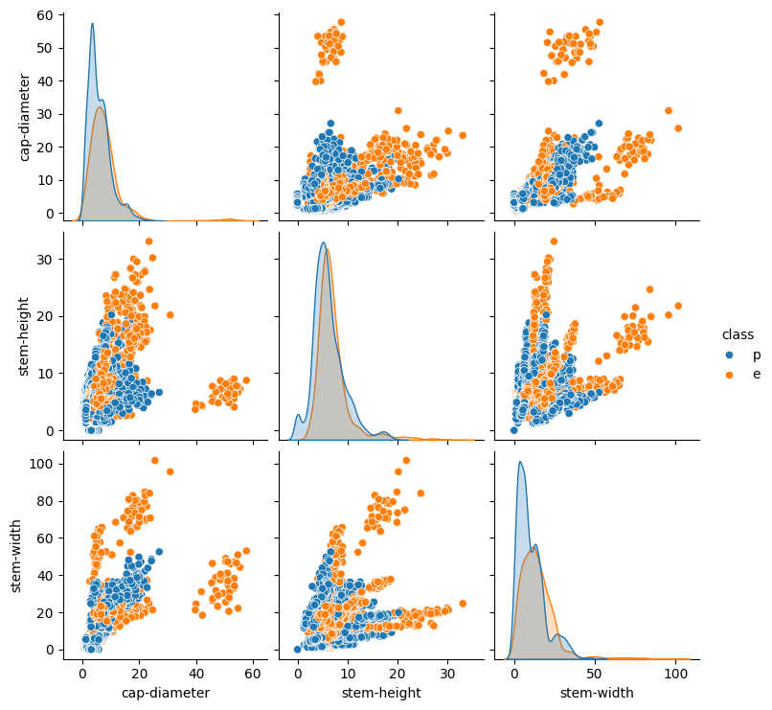
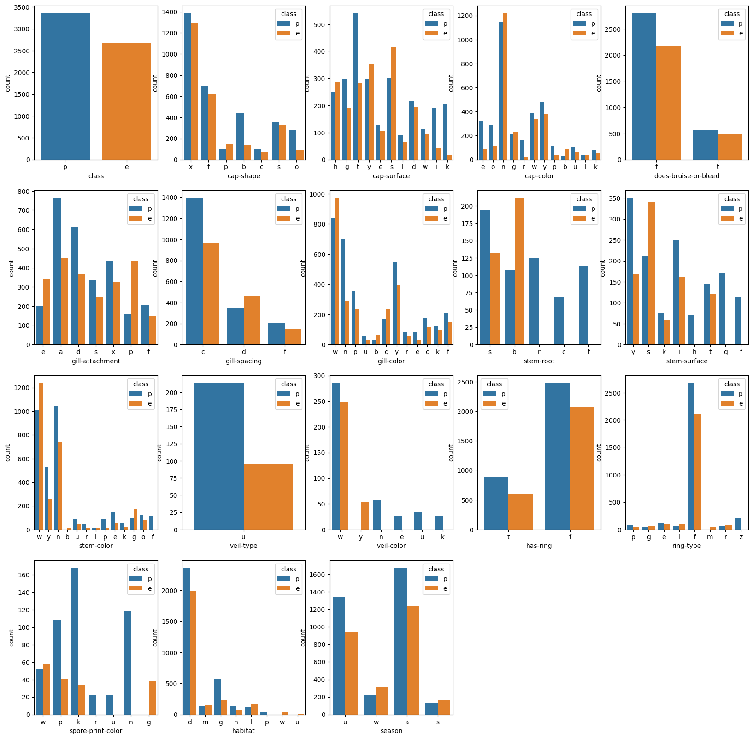
Dataset description

Slide 3
Data Processing

Slide 4
Metrics

Slide 5
Models

Slide 6
Results

Slide 7
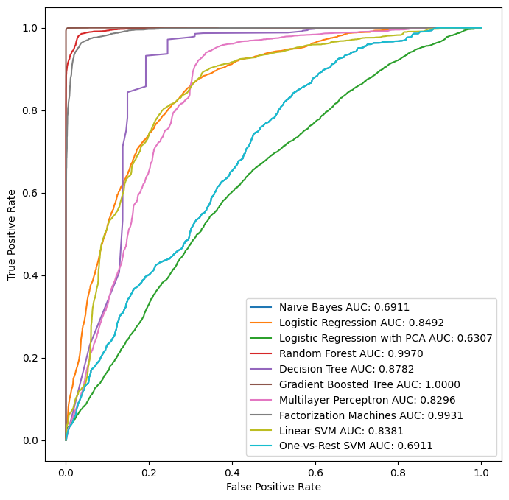
Results
The ROC curves of the models

Slide 8
Project Work

Slide 10
The end

